Slide 1

AI POWERED
EXAM
PROCTORING
PRESENTED BY :
YUKTHA PRAKASH K
TLY22CS067
S7 CSE
GUIDED BY :
Mrs . SHEJINA V
1

Slide 2
ABSTRACT
Online education brings new challenges in ensuring fair exams.
Traditional proctoring is unreliable and tough to manage online.
AI systems use vision, face recognition, and voice analysis to monitor in real time.
These tools detect suspicious acts like looking away or multiple people.
The proposed AI model offers a secure and scalable way to conduct large online exams.
2

Slide 3

CONTENTS
INTRODUCTION
TRADITIONAL VS AI PROCTORING
PROPOSED SYSTEM OVERVIEW
SYSTEM ARCHITECTURE
HOW AI PROCTORING WORKS
DEEP LEARNING MECHANISMS
TECHNOLOGY STACK USED
TYPES OF AI-PROCTORING
REAL WORLD TOOLS
KEY FEATURES
BENEFITS OF AI PROCTORING
LIMITATIONS & CHALLENGES
FUTURE SCOPE & IMPROVEMENTS
CONCLUSION
3

Slide 4
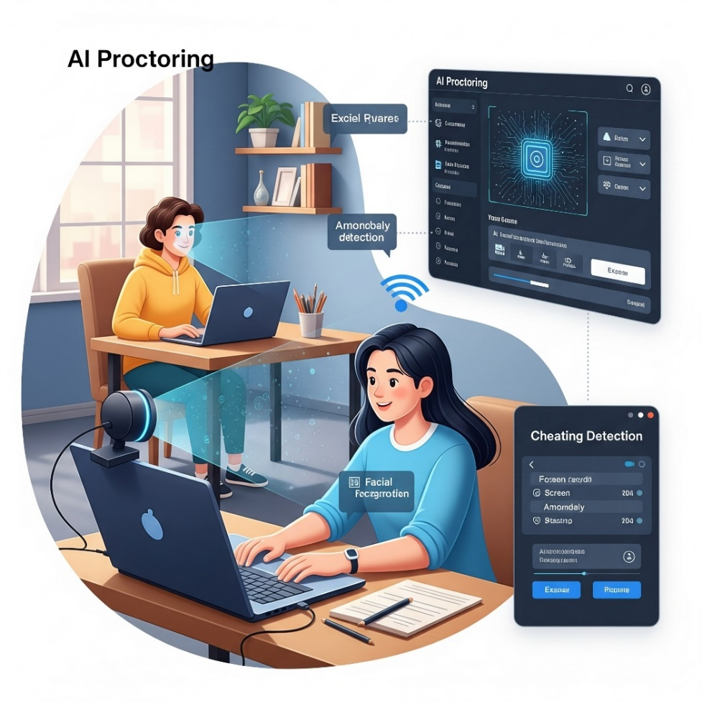
INTRODUCTION
The shift to online education has created a strong need for secure and reliable exam monitoring.
Traditional proctoring methods are difficult to scale and manage in virtual settings.
AI-based proctoring offers an automated, accurate, and real-time solution for detecting cheating.
4

Slide 5

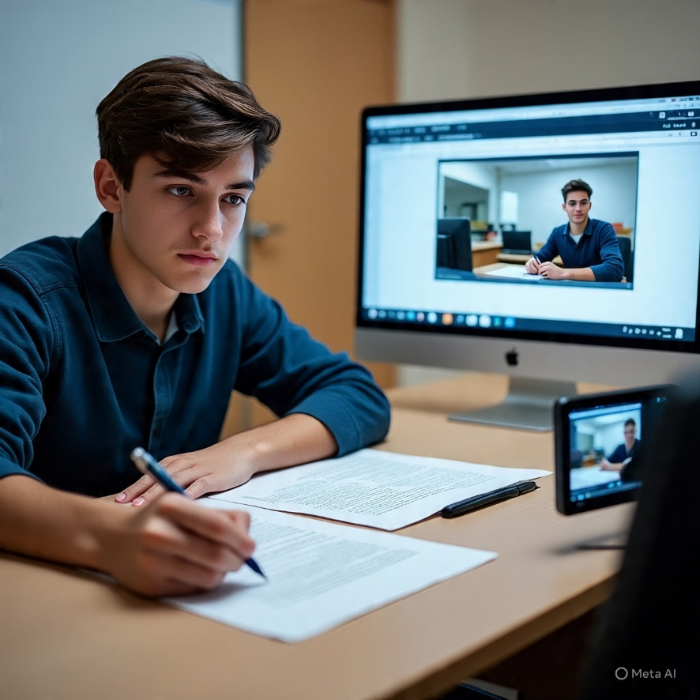
TRADITIONAL VS AI PROCTORING
5

Slide 6

PROPOSED SYSTEM OVERVIEW
The proposed system uses AI to monitor students through webcam, microphone, and screen sharing during online exams.
It continuously analyzes video, audio, and user activity to detect suspicious behavior.
The system generates live alerts and detailed reports for the examiner after the test.
6

Slide 7
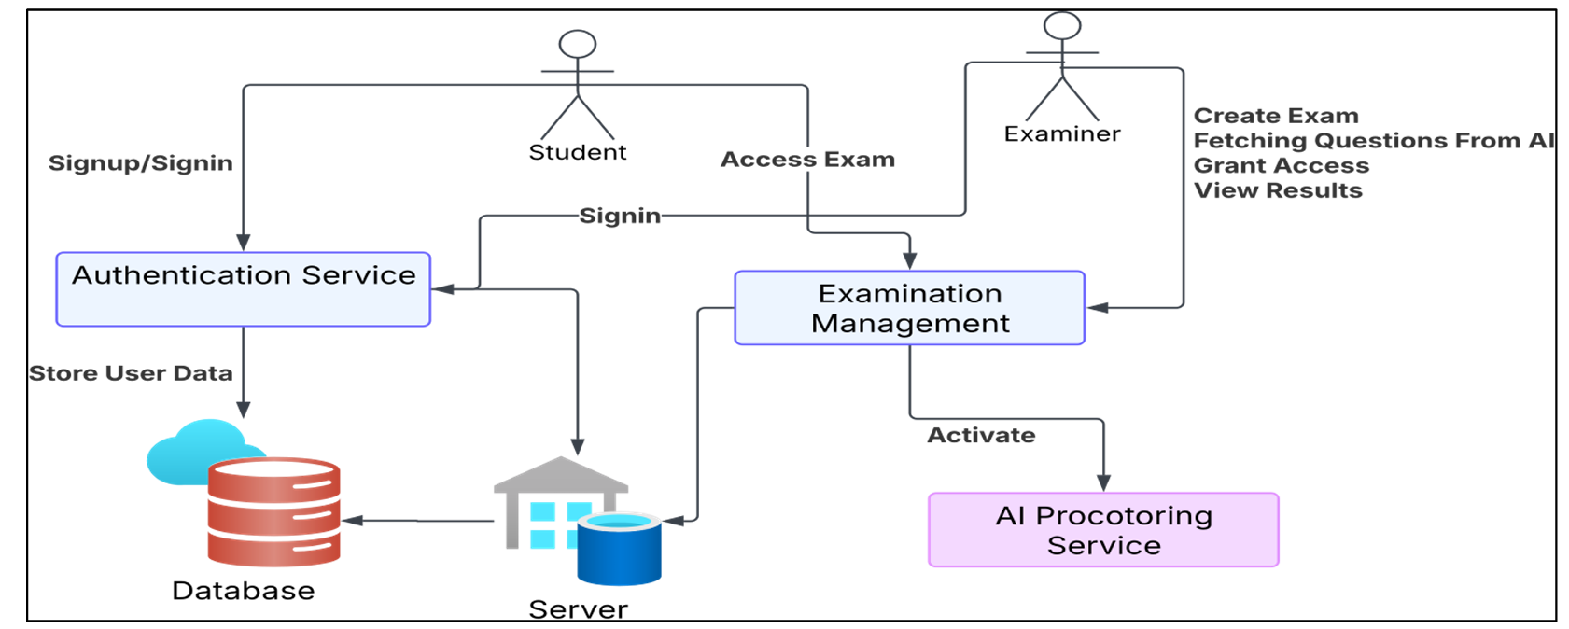
SYSTEM ARCHITECTURE
7

Slide 8

HOW AI PROCTORING WORKS
Student logs in to the exam platform
AI verifies identity using face recognition
1
2
Webcam and mic start monitoring
AI tracks face, eyes, and voice in real-time
3
4
8

Slide 9
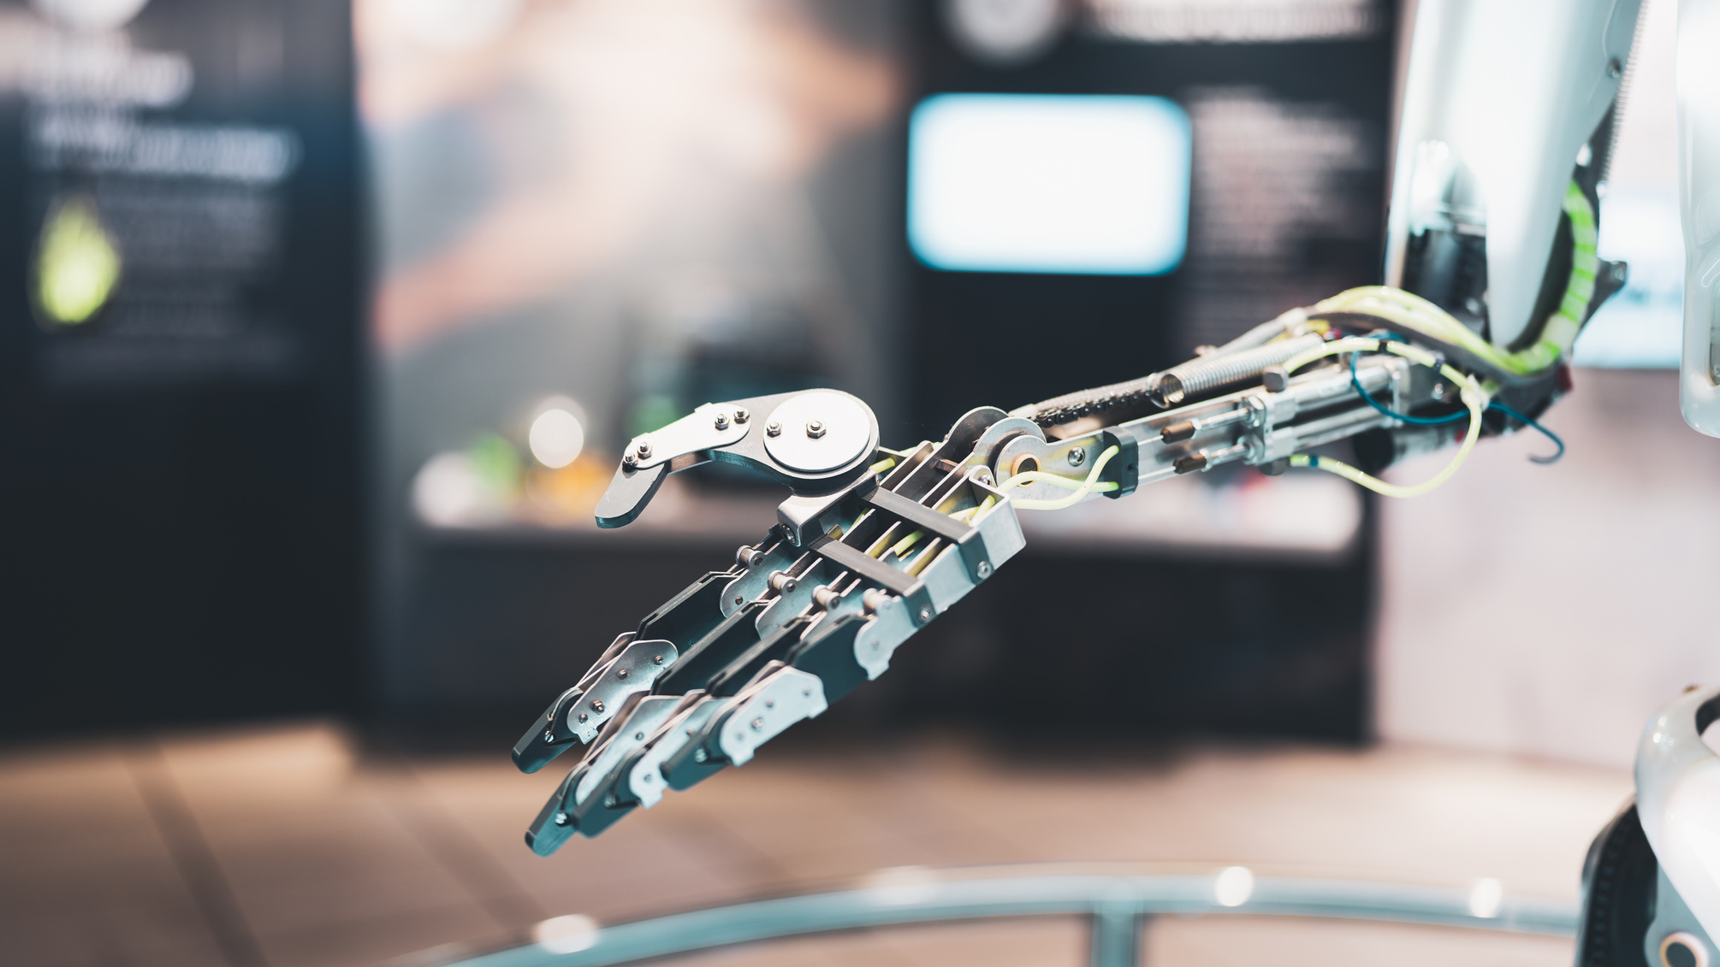

5
6
Screen activity and browser behavior are tracked
Suspicious behavior is flagged automatically
7
A final report is generated after the exam
9

Slide 10
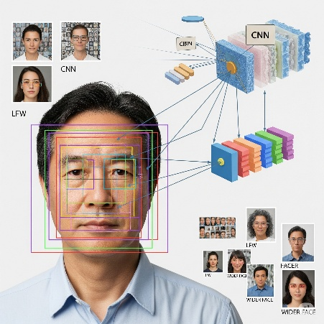
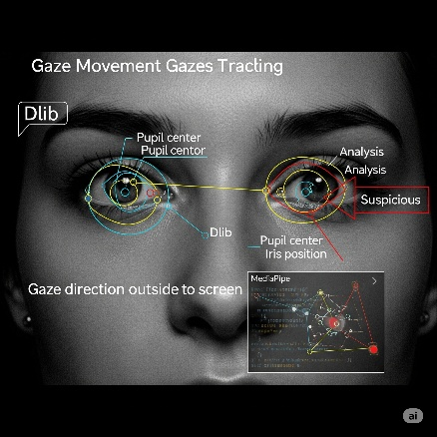
DEEP LEARNING MECHANISMS BEHIND AI PROCTORING
✅
FACE DETECTION – USING DEEP LEARNING
Real-time face detection identifies whether the candidate’s face is present in the webcam feed
Checks for missing face and multiple faces, flagging these as potential integrity breaches
✅
EYE MOVEMENT & GAZE TRACKING
Eye regions are extracted from the detected face.
Pupil center and iris position are analyzed
If gaze is outside screen area → system flags as suspicious
10

Slide 11
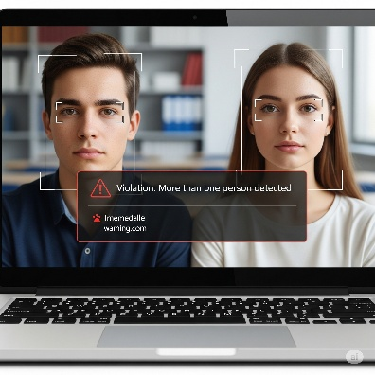

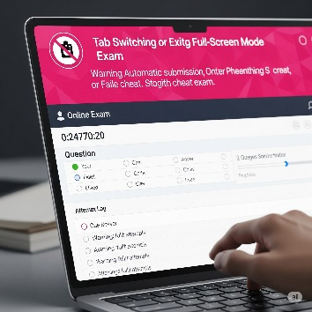
✅
MULTIPLE FACE DETECTION
The system uses face-detection models to count the number of faces visible in the webcam feed
If more than one face is detected (via multiple bounding boxes), the system flags a violation or terminates the exam
✅
OBJECT DETECTION
Real-time object detection checks for unauthorized items like mobile phones or books using webcam footage
If such objects are identified in the frame, the system generates a violation warning
✅
TAB-SWITCH DETECTION
Browser monitoring tools track tab switches or attempts to exit full-screen exam mode
Each switch is logged, and repeated attempts may result in warnings or automatic exam submission
11

Slide 12
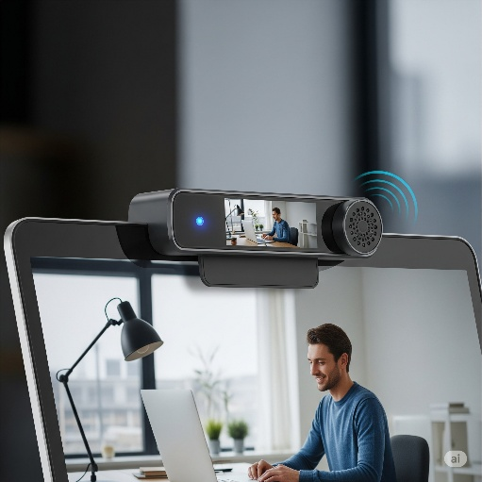

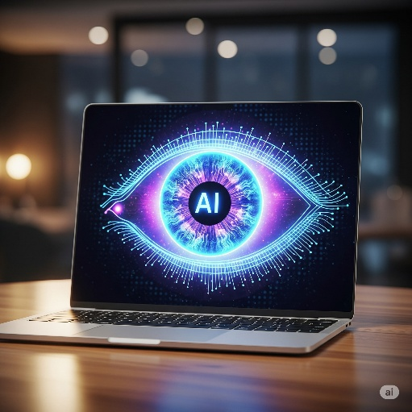
TECHNOLOGY STACKS USED
WEBCAM & MICROPHONE INTEGRATION
Enable real-time capture of video and audio for continuous monitoring.
COMPUTER VISION MODULES
Analyze video to detect suspicious behavior: face absence, multiple people, gaze deviation, and objects like mobile phones.
12

Slide 13
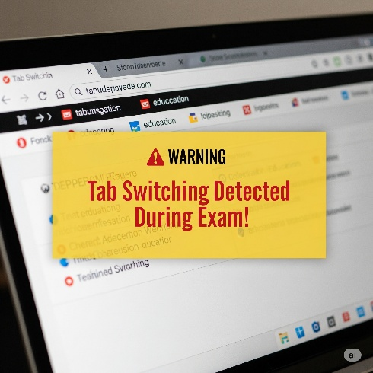


BROWSER ACTIVITY MONITORING
Track tab switching to flag attempts at browsing away from the exam interface.
ROLE-BASED ACCESS CONTROL (RBAC)
Secures examiner and student portals to ensure proper permissions and data protection.
DATA STORAGE & REPORTING
Log infractions and generate real-time or post-exam charts (bar graphs, pie charts) with detailed violation logs.
13

Slide 14

TYPES OF AI-BASED PROCTORING
✅ 1. LIVE PROCTORING
A human watches the student in real-time, assisted by AI
✅ 2. RECORDED PROCTORING
The exam is recorded, and a human checks it later with AI alerts
✅ 3. FULLY AUTOMATED PROCTORING
Only AI watches and flags everything automatically
14

Slide 15
REAL-WORLD TOOLS
Where It’s Used:
Colleges and universities
Online learning platforms
Competitive exams
Mettl – Used for campus hiring and online exams
ProctorU – Combines live and AI proctoring
Examity – Verifies identity and monitors exams
Talview – Tracks face and voice during tests
15

Slide 16
KEY FEAUTURES
Face & Identity Verification
1
5
Browser Activity Monitoring
FEATURES
Gaze & Behavior Tracking
Multiple Face & Object Detection
2
4
3
Voice/Noise Detection
16

Slide 17
BENEFITS OF AI PROCTORING
01
Cost-Effective
Real-Time Alerts
02
24/7 Availability
03
04
Scalable
17

Slide 18

LIMITATIONS AND CHALLENGES
Privacy concerns
False positives
Internet dependency
Student anxiety
18

Slide 19

FUTURE SCOPE OF AI PROCTORING
Emotion detection to understand student stress or intent
Smarter AI with fewer false positives and better accuracy
Hybrid proctoring – AI plus human invigilator combination
Offline support for areas with poor internet connectivity
19

Slide 20
CONCLUSION
AI-powered proctoring offers a smart and scalable solution for online exams
Though challenges like privacy and false alerts exist, technology is improving
With responsible use, AI can make exams fair, secure, and accessible for all
20

Slide 21



REFERENCES
Larana, Inc.
About
Contact
[1] K. L. Narayana, G. Dinesh, K. Karun Kumar, P. P. Adithya, M. H. V. S. Sai, V. C. M. Reddy, “Online Exam Proctoring,” International Journal of Innovative Science and Research Technology (IJISRT),4, April 2025,
[2] Veeramani T, Tharun, Sai Krishna, Tarun Kumar, Leela Prasad, “Online Exam Proctoring System Based on Artificial Intelligence,” International Journal of Novel Research and Development (IJNRD), 4, April 2024.
[3] Anil Kumar K, Rakesh L, Harsha G, Ganesh L, “AI Based Online Exam Proctoring System,” International Research Journal of Modernization in Engineering Technology and Science (IRJMETS),6, June 2024.
[4] A. K. Patel, P. V. Mehta, B. S. Sharma, “AI Based Automated Online Exam Proctoring System,” International Journal of Creative Research Thoughts (IJCRT),6, June 2024.
Page
1
21

Slide 22
Larana, Inc.
About
Contact
THANK YOU
Page
1
22

